Slide 1
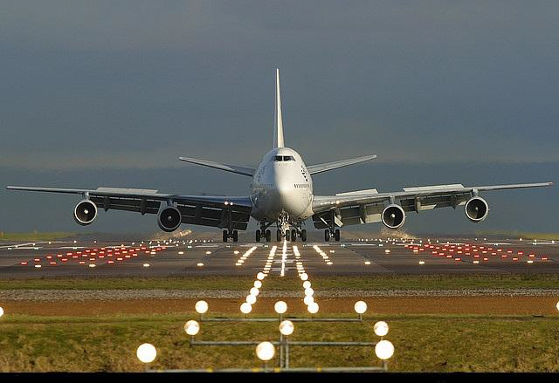
AIRLINE RESERVATION SYSTEM

Slide 2

_{Prepared by}
SMIT SHAH : 18DCS112

Slide 3
ABSTRACT :
Airline Reservation System contains the details about flight schedules and its fare tariffs, passenger reservations and ticket records.
An airline’s inventory contains all flights with their available seats. The inventory of an airline service is having seats up to 63 bookings, along with prices and booking conditions.
Inventory data is imported and maintained through a Schedule Distribution System over standardized interfaces. determined.

Slide 4
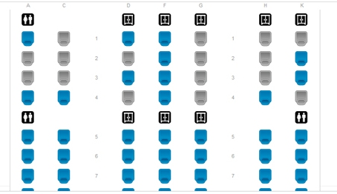
One of the core functions of the inventory management of airline reservations is the inventory control. Inventory control steers how many seats are left after booking and information of passengers already booked, by opening and closing individual booking for sale.

Slide 5
INTRODUCTION
Existing System :
In few countries if a person wants to book a flight ticket, he use to follow one of these things:
Manually goes to the Airport and book his ticket.
Downloading the ticket form as paper document, filling it manually and submitting it at Airport.
Fill the Ticket form on system and get the print out as paper documents to submit it at Airport.
Booking the Ticket at some particular registered ticket counters in online.

Slide 6


Hence the Passenger may or may not be satisfied with this approach as it includes manual intervention like travelling to Airport for booking his tick

Slide 7

Proposed System:
The Proposed system ensures the complete freedom for users, where user can book his ticket. Our proposed system allows users to book the tickets, view timings.
In this Proposal the entire work is done on softwares like CODE BLOCKS and online project managing site Github. Reservation seat number is also provided for passengers as a print document. Here passengers can able to see the booking details

Slide 8
PURPOSE AND MOTIVATION
The main purpose of this project is to list the requirments of the Airline reservation system.
This document is mainly prepared to set stage for the design phase of the project.
Our interest is to learn this new technology has promoted us to take up this project, which would set a stage for the application I would be developing in the future.

Slide 9
FEATURES
Enter the details of the traveler.
Check for availability of tickets.
Provide different discount for a different person as per rules which will be display on a screen.
Issue the ticket.
Search the passengers information by entering their reservation number.
To cancel the already booked seat by its reservation no.
Show the sitting arrangement to the traveler to book a suitable seat for him.

Slide 10
MODULE AND PROCESS
WELCOME SCREEN
Make reservation
Search passenger
Discount
Cancel reservation
Print status report
Exit
Seat arrangement
Choice for meal
Discount rules

Slide 11
TOOLS AND TECHNOLOGY
Software And Programs Used:
A number of software and programs have been used in order to develop the sample booking system.
The types of programs and software used were programming languages such as OBJECT ORIENTED C++ and for that compiler CODE BLOCKS is used.
Basic understanding of the programs were utilized in the completion of the project.

Slide 12

Sources such as tutorial videos for some concepts and official documentations of airline reservation system were referred to in the case of insufficient knowledge during the development process.

Slide 13
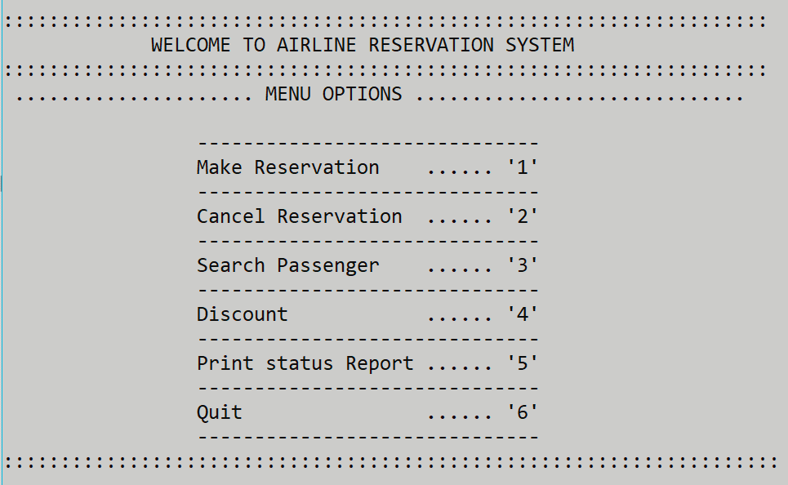
IMPLEMANTATION SCREENSHOTS
WELCOME SCREEN AND MENU:

Slide 14
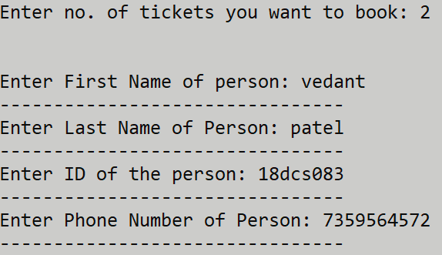
BOOKING:- 1) MAKE RESERVATION :

Slide 15
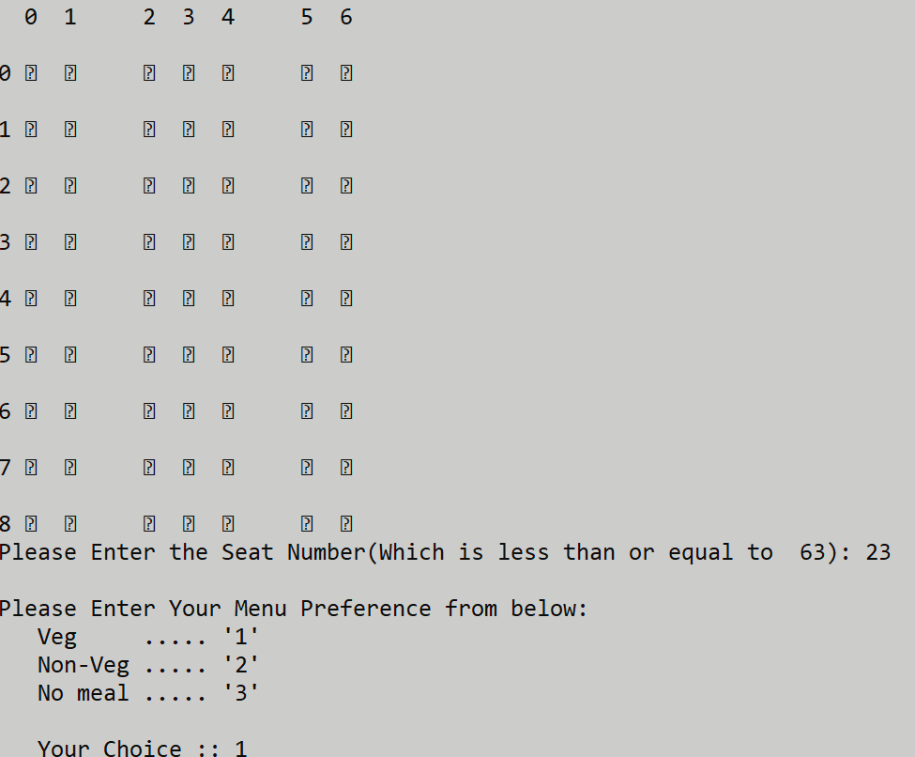
Seat arrenge-ment & meal choices :

Slide 16
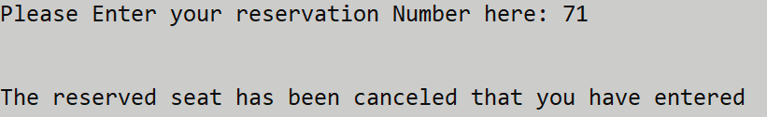
2) Cancle reservation :

Slide 17
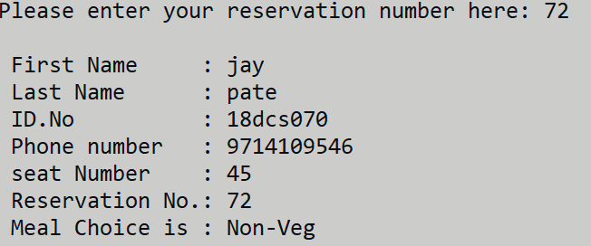
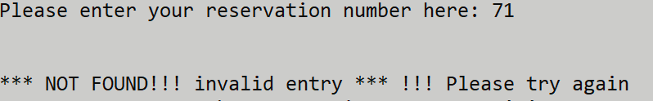
3) Search passenger :

Slide 18
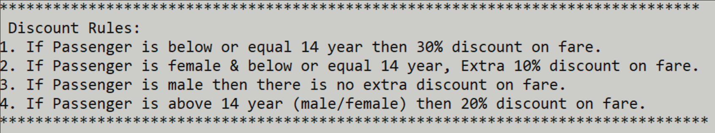
4) Displaying discount rule :

Slide 19
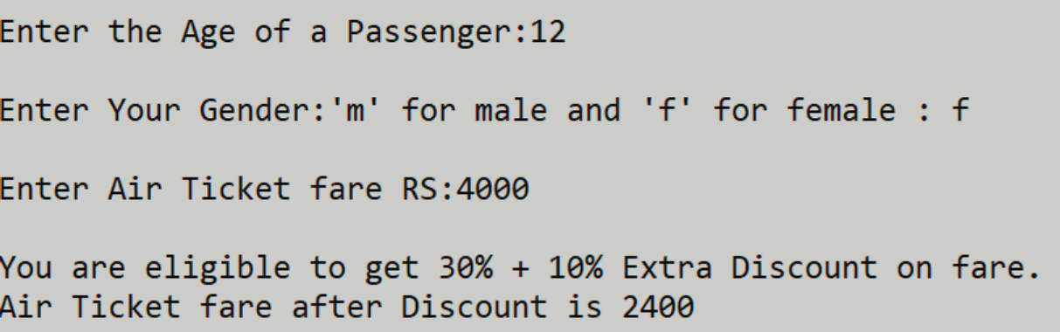
5) Amount displayingafter calculation discount :

Slide 20

6) Print status report :

Slide 21
CONCLUSION
In the existing system there is no provision for senior citizen concession and there is no facility for viewing single passenger record. The purpose of developing the specified project is to describe the analysis involved in the reservation of air ticket.

Slide 22


